Slide 1

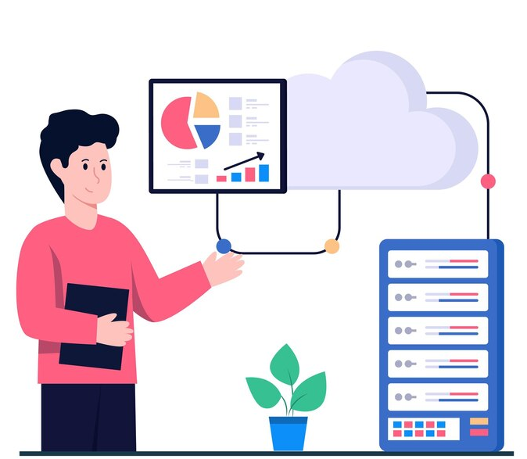
Cloud Fundamentals & Scalability
Understanding Cloud Infrastructure & Scaling
1

Slide 2
Session Agenda
01
02
Cloud Computing Overview
IaaS vs PaaS vs SaaS
03
04
Regions & Availability Zones
What is Elasticity?
05
06
Real-World Scaling Examples
Load Balancer Concept
07
08
Horizontal vs Vertical Scaling
Scenario Discussion
2

Slide 3
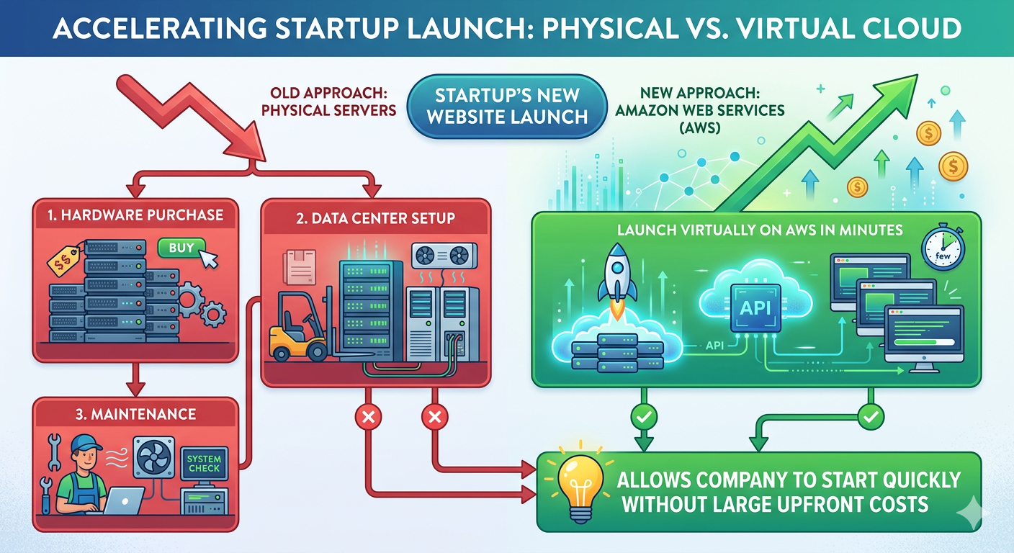

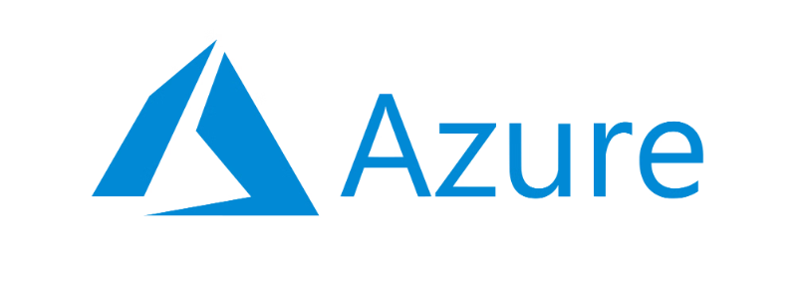

CONCEPT INTRODUCTION
What is Cloud Computing?
Example: A startup wants to launch a new website.
Cloud computing delivers on-demand computing resources over the internet on a pay-as-you-go model — rent servers instead of buying them.
AWS
Azure
GCP
Amazon Web Services
Microsoft Azure
Google Cloud
3

Slide 4




Why Cloud?
No Hardware Management
Fast Provisioning
Eliminate physical server maintenance entirely.
Deploy in minutes, not weeks.
Global Availability
Cost Flexibility
Reach users anywhere in the world.
Automatic scaling keeps costs aligned with usage.
Traditional vs Cloud:
Weeks to deploy → Minutes to deploy.
4

Slide 5

IAAS VS PAAS VS SAAS
IaaS – Infrastructure as a Service
Provider Manages
You Manage
Virtual Machines
Storage
OS
Applications
Networking
Example: Virtual server on AWS EC2
5

Slide 6

PaaS – Platform as a Service
Provider Manages
Runtime environment
Operating system
Development platform
You Manage
Application code only
Example: Deploy apps without managing servers
6

Slide 7
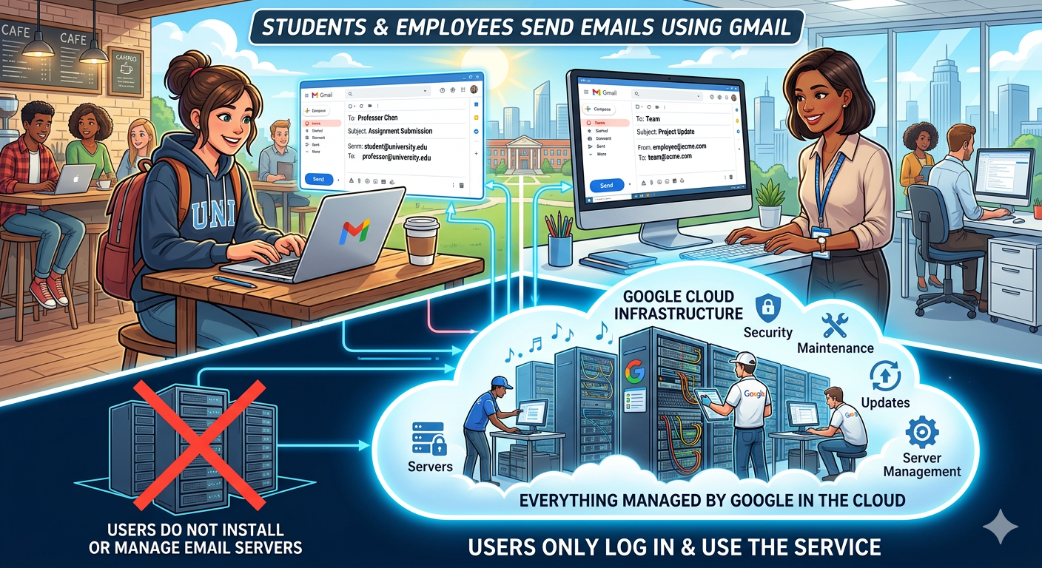



SaaS – Software as a Service
Fully managed software accessible via browser — you manage usage only.
Example: Students and employees send emails using Gmail.
Gmail
Slack
Email
Messaging
Zoom
Video Calls
7

Slide 8
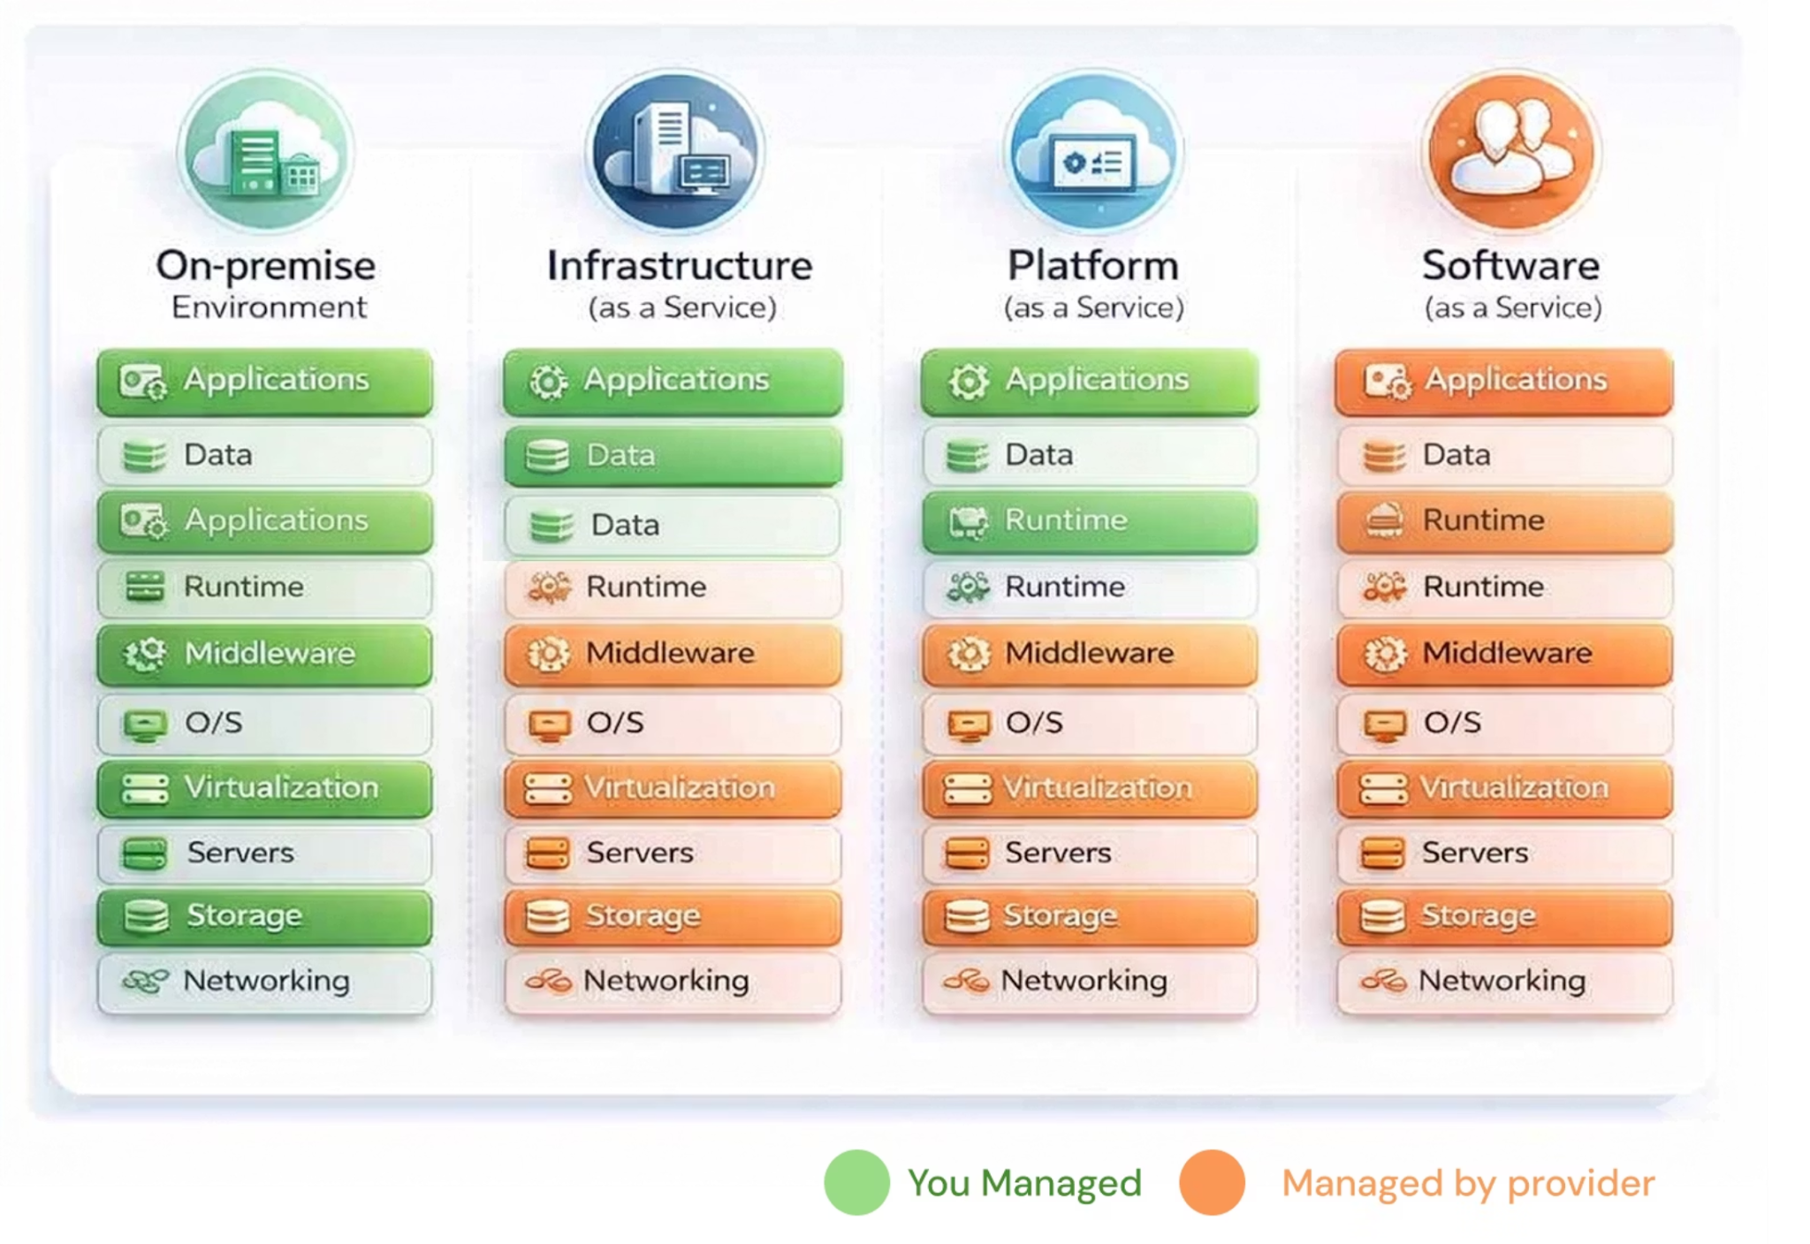
IaaS vs PaaS vs SaaS
8

Slide 9
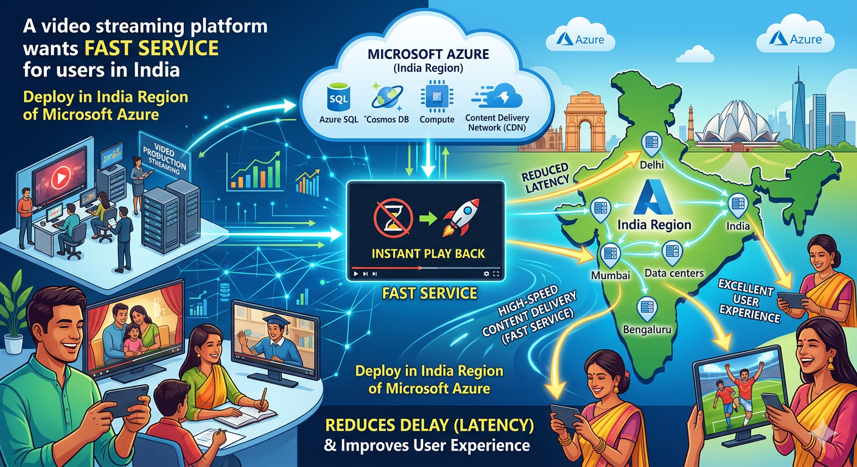
REGIONS & AVAILABILITY ZONES
Example: A video streaming platform wants fast service for users in India.
What is a Region?
A region is a geographical location containing multiple data centers. Regions are chosen for low latency and legal compliance.
US-East
Asia-South
Europe-West
9

Slide 10
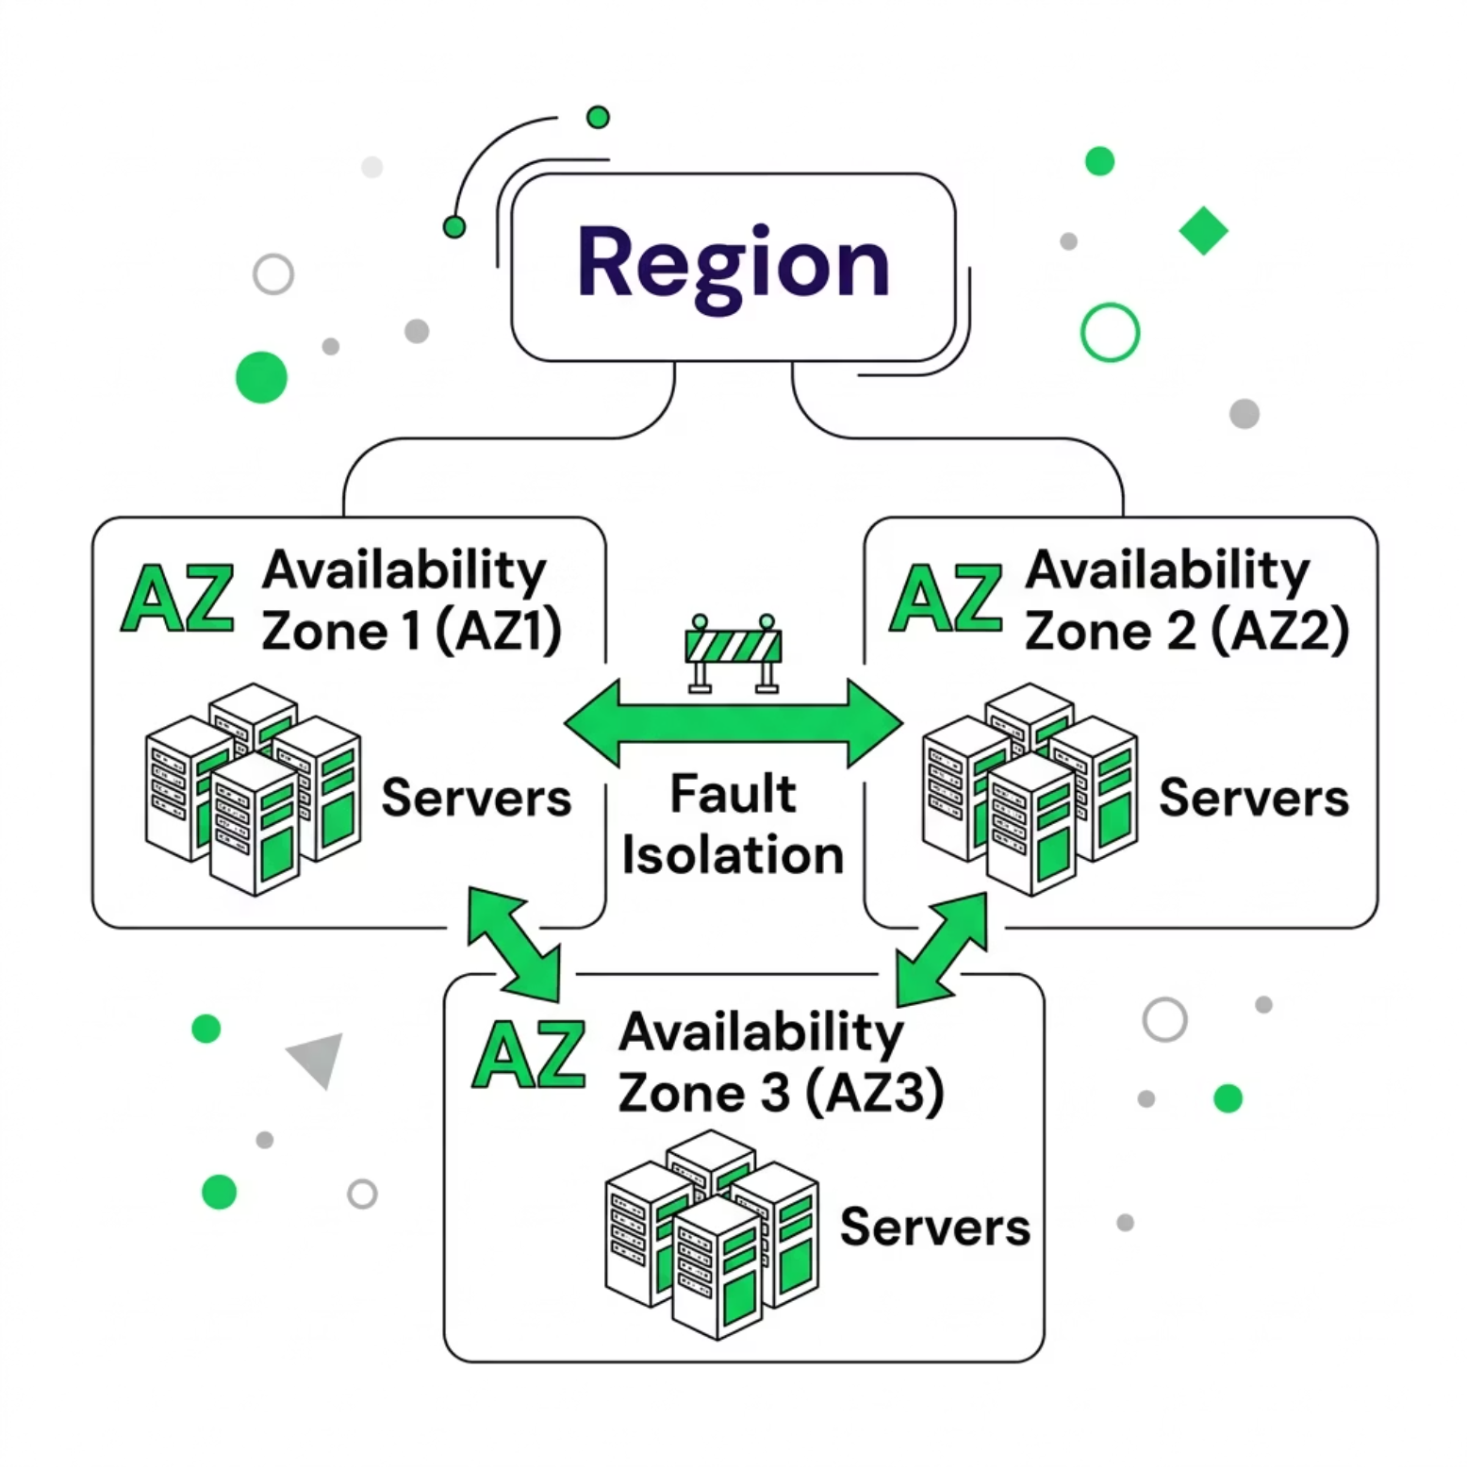

What is an Availability Zone?
An Availability Zone (AZ) is a separate, isolated data center within a region. Multiple AZs prevent a single point of failure.
Region → Multiple AZs → High Reliability
10

Slide 11
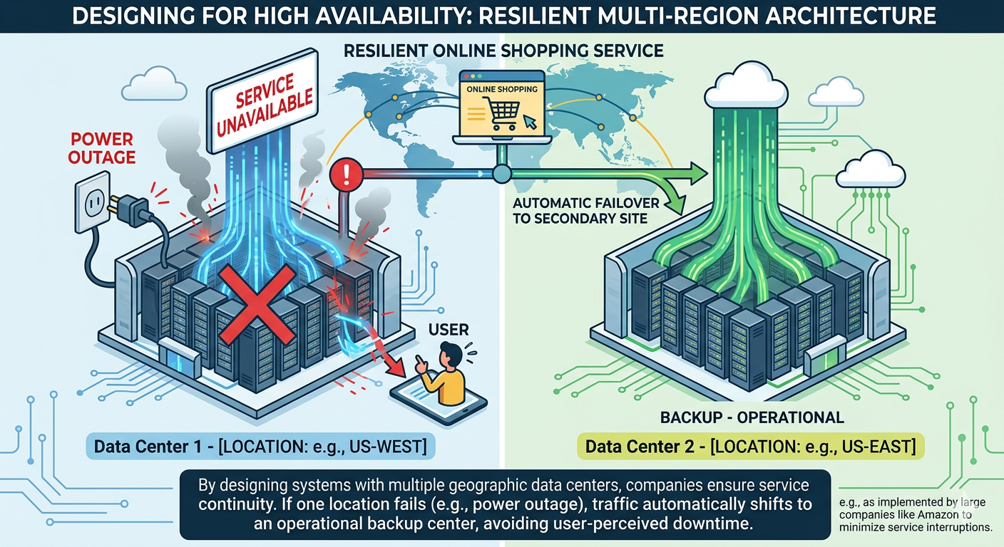
Example of an Availability Zone
An online shopping platform runs its application in multiple data centers.
If one data center fails due to power outage, another one continues running the service.
Large companies like Amazon design systems this way to avoid downtime.
11

Slide 12
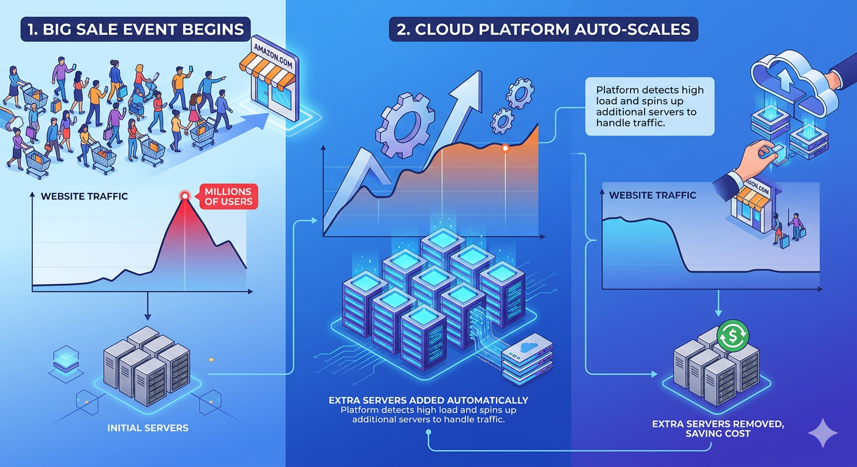

WHAT IS ELASTICITY?
What is Elasticity?
The ability to automatically scale resources up or down based on demand — and pay only for what you use.
Example: During a big sale event on Amazon, millions of users visit the website.
More Users
Add servers automatically
Less Users
Remove servers automatically
12

Slide 13
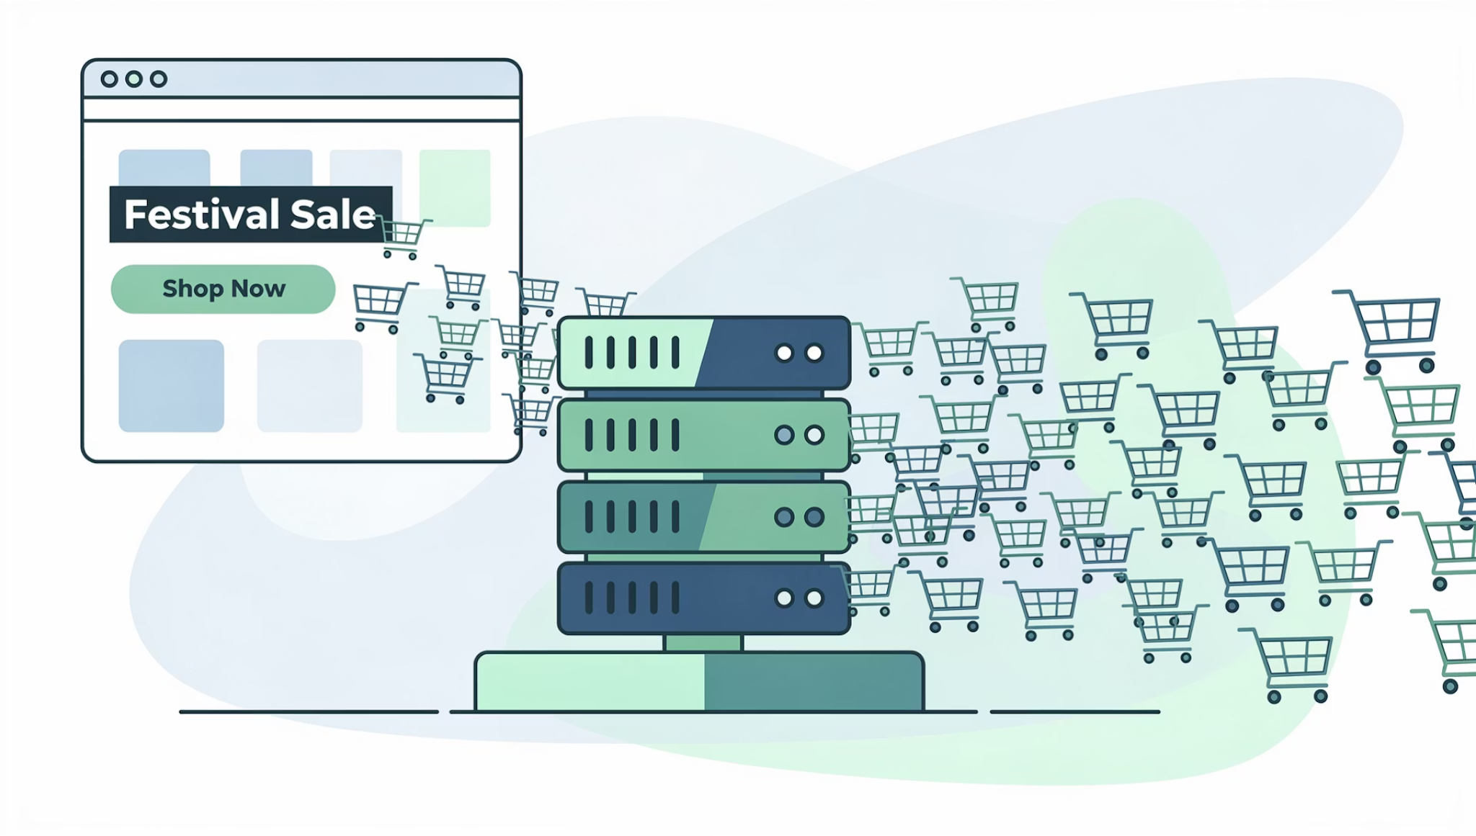
REAL-WORLD EXAMPLES
Festival Traffic Spike
Without scaling: Website crashes.
With Cloud Elasticity: Auto-scale servers to handle the spike, then scale down after.
Normal
Festival
10,000 users
1,000,000 users
13

Slide 14
Startup Going Global
The Challenge
Benefits
A startup initially serves India only. After success, it expands to US & Europe.
Reduced Latency
Better UX
The Solution
Servers closer to users
Faster load times globally
Deploy apps in multiple regions.
Compliance
Meet local data laws
14

Slide 15

Cost Optimization with Cloud
Without Cloud
Servers run all night → Wasted money
With Cloud
Auto scale down at night → Save cost
15

Slide 16
Quiz Time
Q1. A startup wants to launch a website quickly but cannot afford to buy physical servers.
What is the best solution?
✅ Answer: Use cloud services from providers like Amazon Web Services to create virtual servers on demand.
Q2. A company wants employees to access email from any device using a browser.
Which cloud service model fits this need?
✅ Answer: SaaS (Software as a Service), such as Gmail.
Q3. Your application users are mainly in India. Where should you deploy your cloud server for better performance?
✅ Answer: In a cloud region close to India using platforms like Microsoft Azure or Google Cloud to reduce latency.
16

Slide 17
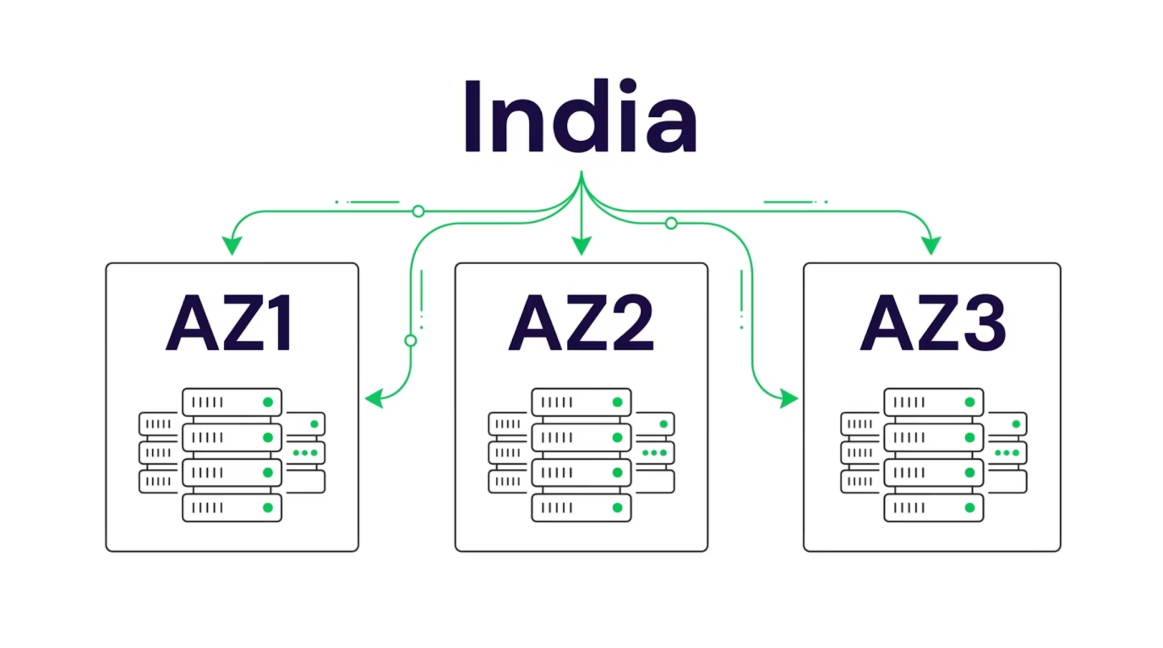

DEMO / DIAGRAM
Region & Availability Zone Diagram
Deploy across multiple AZs within a region to ensure high reliability and eliminate single points of failure.
17

Slide 18
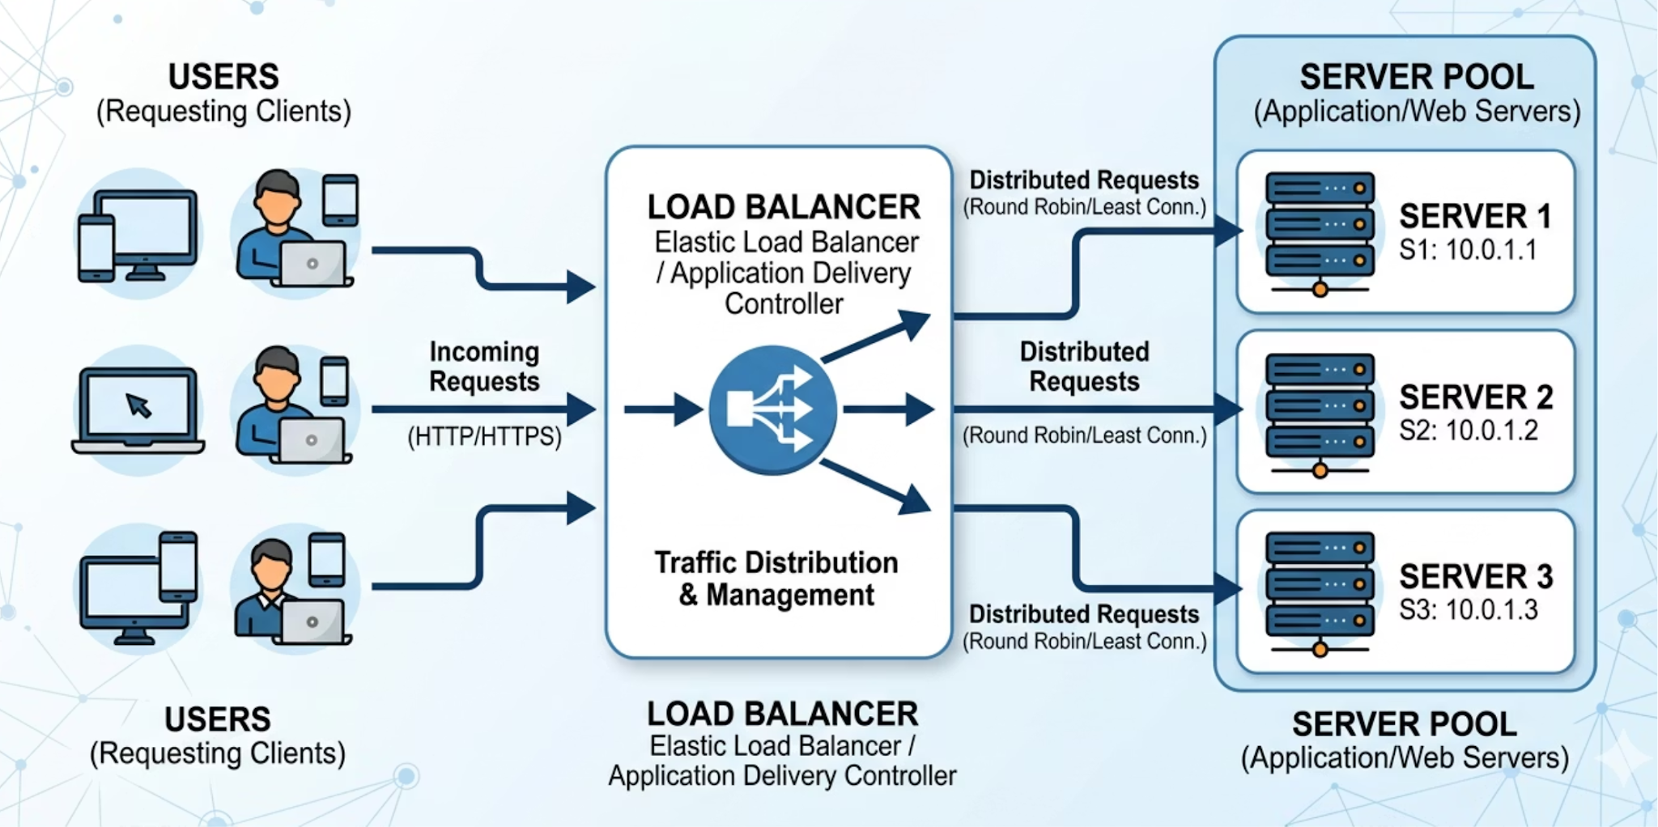

Load Balancer Concept
A load balancer distributes incoming traffic across multiple servers — preventing overload and improving availability.
Users → Load Balancer → Server 1 / Server 2 / Server 3
18

Slide 19
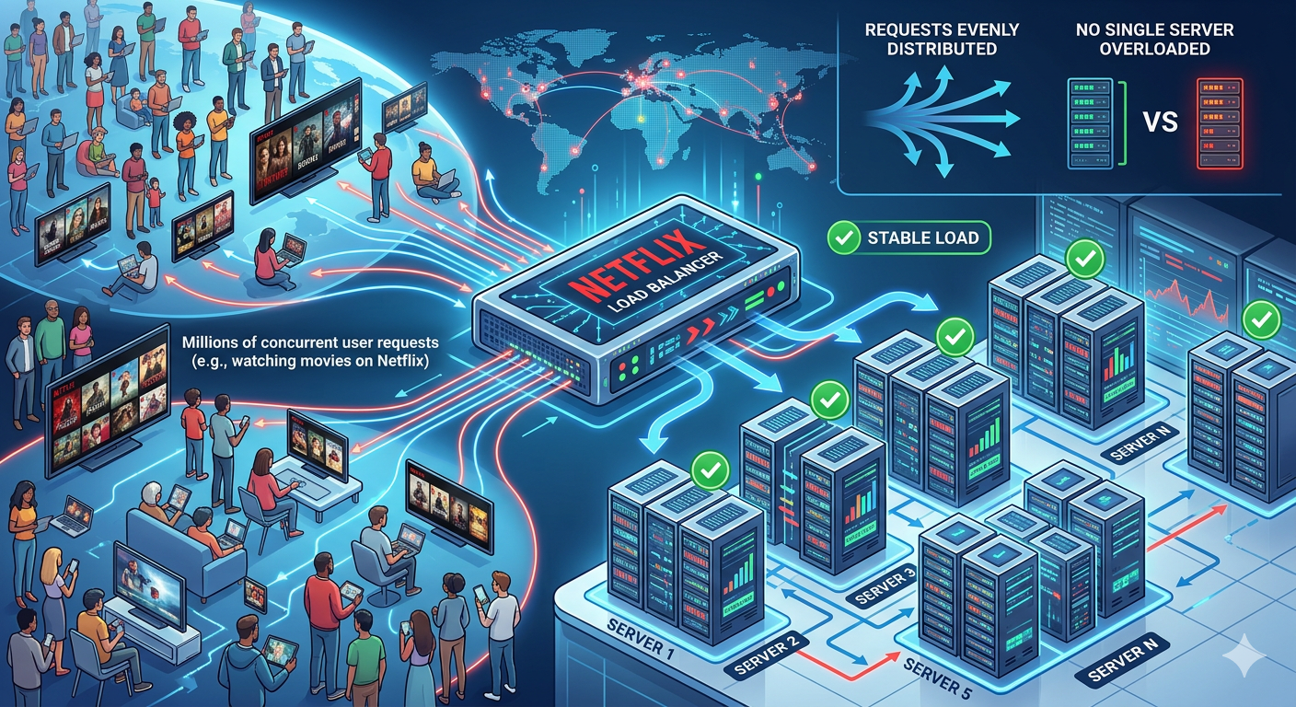
Example of Load Balancer
When millions of users watch movies on Netflix, a load balancer sends requests to different servers.
This prevents any single server from becoming overloaded.
19

Slide 20
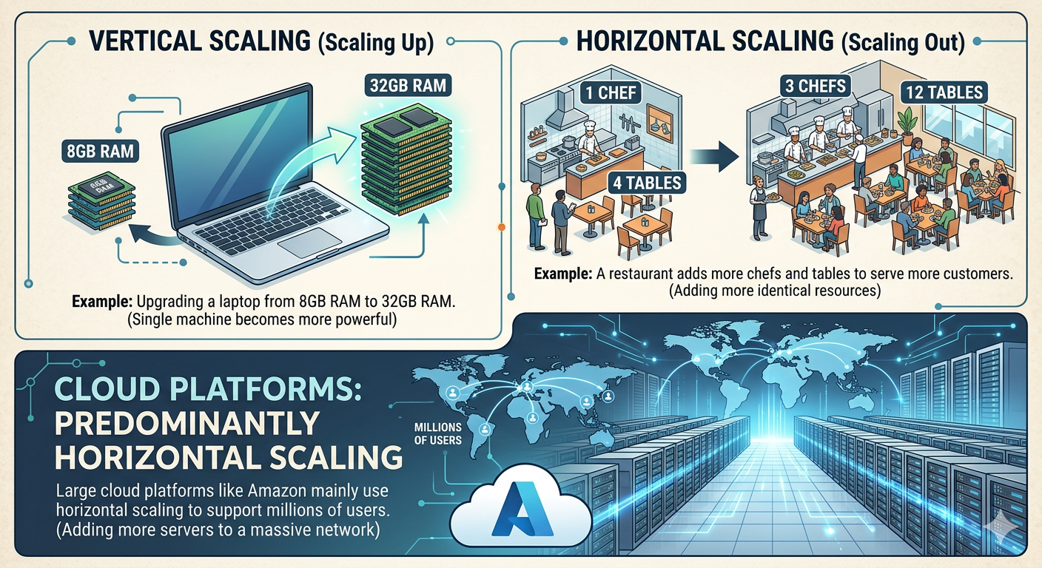
Horizontal vs Vertical Scaling
Example:
⬆ Vertical Scaling
Increase CPU/RAM on existing server.
Example: 4GB → 16GB RAM
Limitation: Hardware ceiling
➡ Horizontal Scaling
Add more servers to distribute traffic.
Example: 1 server → 10 servers
Requires: Load Balancer
20

Slide 21
Quiz Time
Q1. If an application runs on only one server and that server crashes, what happens?
✅ Answer:
The entire application becomes unavailable.
Using multiple servers across cloud infrastructure like Amazon Web Services improves reliability.
Q2. Why do large applications run in multiple data centers instead of one?
✅ Answer: To prevent downtime and ensure the service continues running even if one data center fails.
Q3. A website becomes very slow because too many users are accessing the same server. What component can distribute traffic to multiple servers?
✅ Answer: A Load Balancer, commonly used in cloud platforms like Google Cloud.
21

Slide 22

SCENARIO DISCUSSION
Scenario: Traffic Increases 100x
01
02
03
Enable Auto Scaling
Use Load Balancer
Multi-AZ Deployment
04
05
Optimize Database
Use CDN
22

Slide 23
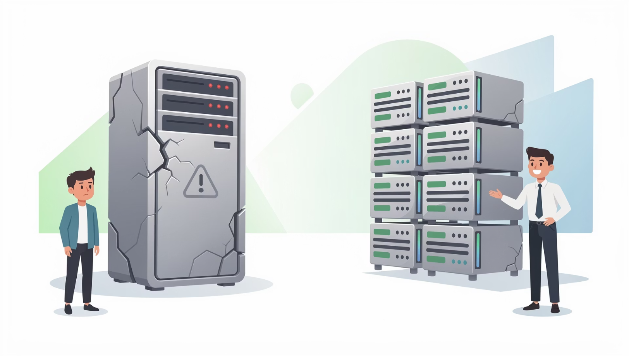


Avoid Single Point of Failure
Single Server = Risk
Uses:
Multiple Servers
Multiple AZs
Backup Database
Monitoring & Alerts
Scalability + Reliability go together.
23

Slide 24
DISCUSSION
Questions to Consider
1
2
3
Can vertical scaling alone handle 100x growth?
Why deploy in multiple AZs?
Is cloud always cheaper?
4
5
What happens if the load balancer fails?
How does elasticity save money?
24

Slide 25




SUMMARY
Key Takeaways
Cloud Basics
IaaS / PaaS / SaaS
On-demand, pay-as-you-go computing over the internet.
Three service models with different management responsibilities.
Regions & AZs
Scaling & Load Balancing
Geographic distribution for latency, compliance, and reliability.
Elasticity, horizontal vs vertical scaling, and traffic distribution.
25

Slide 26


Thank You
26

